Slide 1





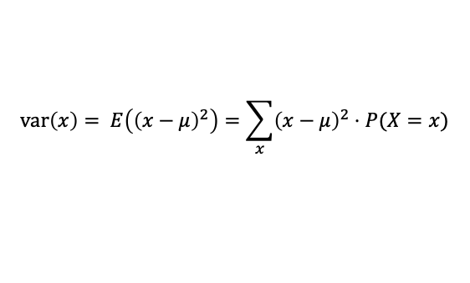





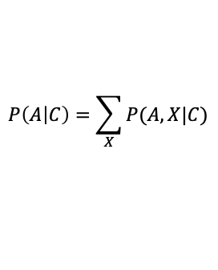



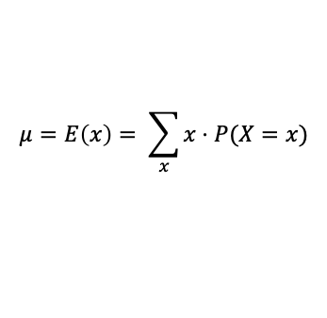


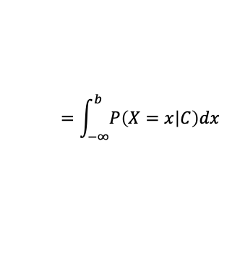





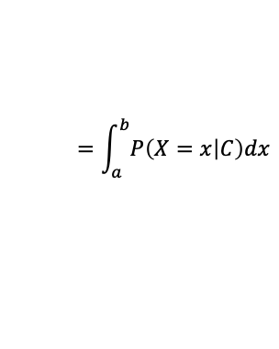


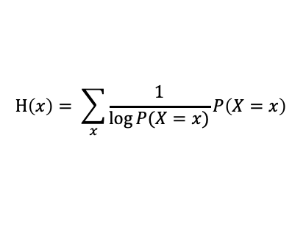


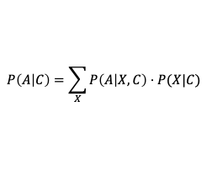



Probability cheatsheet
Gavin Band, WHG GMS Programme 2021
4. Probability for variables
1. Probability expresses uncertainty:
Often $X$ will instead denote a variable whose value we are uncertain of. It is typical to use lower-case letters like $x$ to denote specific possible values. So we will write:
$$P\left(X | C\right)=0$$
=> “X is definitely not true”
$$P\left(X=x | C\right)$$
“Probability $X$ takes value $x$”
$$P\left(X | C\right)=1$$
=> “X is definitely true”
Extends basic logic
$$0<P\left(X | C\right)<1$$
=> we are uncertain about X
For a continuous variable $X$ we must instead think of P as a density function:
$$P\left(X=x | C\right)$$
“Probability density function (pdf) evaluated at $X=x$”
2. All probability is conditional:
and integrate it to get an actual probability:
always means
$$P\left(a≤ X≤b | C\right)$$
$$=\int_{a}^{b}{P\left(X=x | C\right)dx}$$
“Probability that $X$ is between $a$ and $b$”
$$P(X)$$
$$P(X|C)$$
“probability of X”
“probability of X given C”
$$=\int_{−∞}^{b}{P\left(X=x | C\right)dx}$$
“Cumulative distribution function (cdf) of $X”$
or “probability of X conditional on C”
$$P\left( X≤b | C\right)$$
where C represents background information (such as an assumed statistical model). C is often dropped from notation but is always there.
Inverse of cdf is the quantile function.
$$\text{pdf}$$
$$\text{c}\text{df}$$
Examples:
P( | die is fair) = 1/6
P( transmission | model of infection)
etc.
0.95
$$1$$
Model of die
0.75
probability distribution must sum to 1
3. Probability is computable:
5% of the mass is here
0.5
I.
$$P\left(!A | C\right)=1−P(A|C)$$
(A either occurs or doesn’t.)
95% of the mass is here
0.25
0.05
“not A”
$$0$$
II.
$$P\left(A \text{or} B | C\right)$$
$$=P\left(A | C\right)+P\left(B | C\right)−P(A,B|C)$$
(One of them must occur,
but don’t double-count)
“5% quantile”
“5% quantile”
“50% quantile”
or
“median”
“95% quantile”
“A and B given C”
5. Common distributions
III.
$$P\left(A,B | C\right)$$
$$=P\left(A | B,C\right)⋅P(B|C)$$
(Split up joint probabilities into conditional ones.)
Probabilities are often expressed in terms of a set of well-known distributions
“A and B given C”
“A given B and C”
“B given C”
“Independence” happens in when the middle term simplifies: $P\left(A,B\right)=P\left(A\right)P(B)$
$$X \sim N(0,1)$$
“$X$ has a standard normal (or Gaussian) distribution”
$$X \sim \text{binom}(N,p)$$
“$X$ has binomial distribution with $N$ draws and success probability $p$”
4. Practically useful tools for computation:
(derived directly from the rules in 3)
See the separate ‘distributions cheatsheet’ for more.
LOTP:
(“Law of
total probability”)
$$P\left(A | C\right)=\sum_{X}{P(A,X|C)}$$
Computes probability of A by summing (or integrating) over all the possible values of another variable.
6. Useful statistical summaries
value
pdf
“Mean“ or “expected value”
$$μ=E\left(x\right)= \sum_{x}{x⋅P(X=x)}$$
Average of $x$ over all possible values
Often seen as
$$P\left(A | C\right)=\sum_{X}{P\left(A | X,C\right)⋅P(X|C) }$$
by applying rule III
“Variance“
$$\text{var}\left(x\right)= E\left({\left(x−μ\right)}^{2}\right)=\sum_{x}{{\left(x−μ\right)}^{2}⋅P(X=x)}$$
Average squared distance to mean
(a useful measure of uncertainty)
Bayes’ rule:
$$P\left(A | B,C\right)$$
$$=\frac{P\left(B | A,C\right)⋅P(A|C)}{P(B|C)}$$
Computes P(A given B)
in terms of P(B given A)
“Entropy“
$$\text{H}\left(x\right)= \sum_{x}{\frac{1}{\log{P(X=x)}}P\left(X=x\right) }$$
average information provided by $x$
(also a measure of uncertainty)

